Slide 1






Middleware for Automated use of Edge Resources In Campus networks
www.maveric-project.org

Slide 2
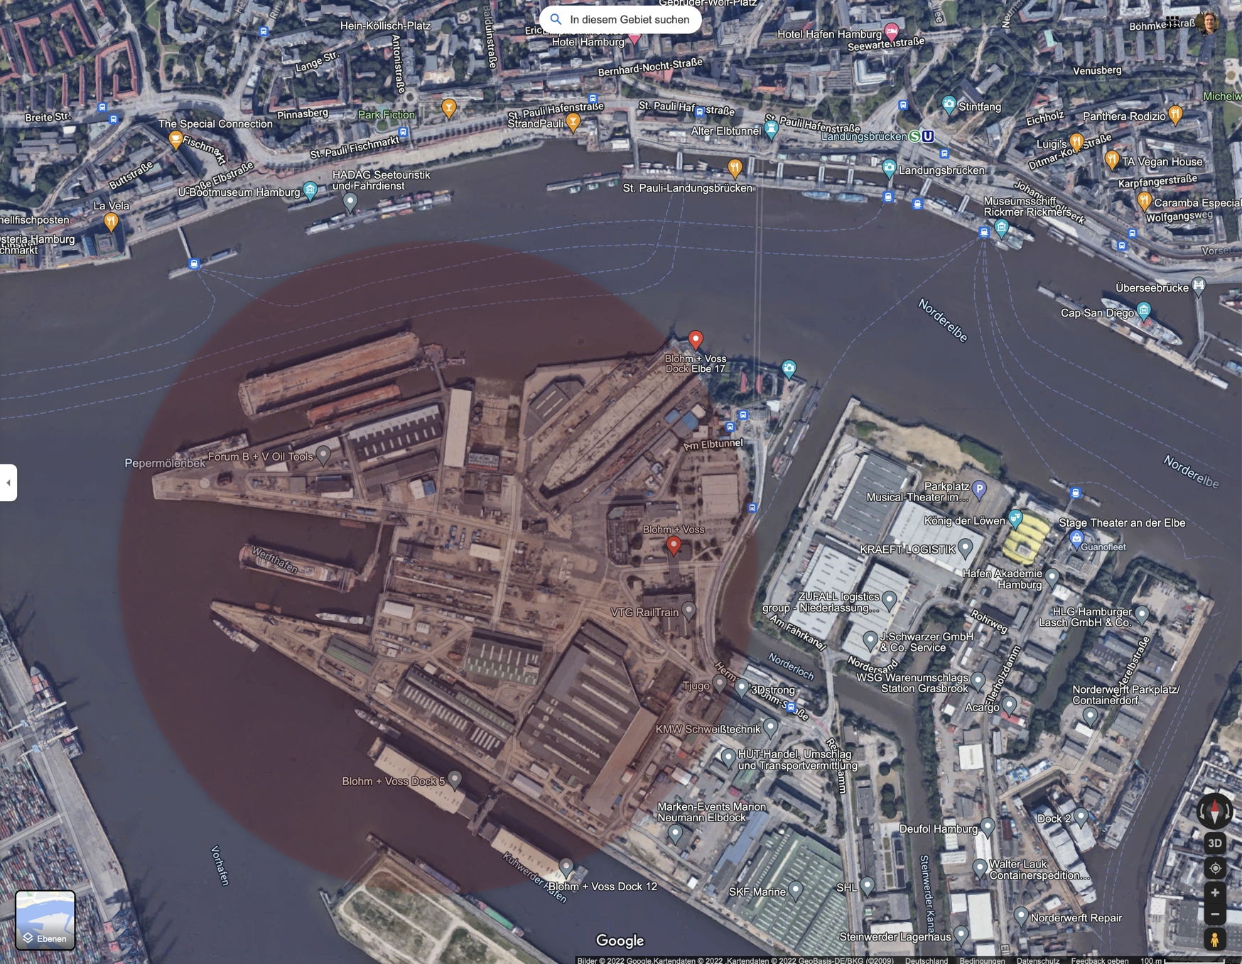
Objectives
Middleware for Automated use of Edge Resources In Campus networks
Challenges
Difficult radio environments
Unstable backhaul, Pop-Up networks
Adequate robust application support
Ubiquitous access to online resources (manuals etc.)
Application proxies (edge computing)
Automatic distribution of application proxies and state synchronization after disconnections
Support for heterogeneous deployments
5G (ORAN, BBU+RRU), LTE, WLAN
Assess technical and economic case for ORAN
Security
Zero-Trust needed for radio network
Secure integration into enterprise networks and AAA infrastructure

Slide 3
Use Cases
Overview
Ubiquitous coverage for “always-on” access
Whole campus
General-purpose networking
Ship in construction (in dock, at pier)
In-ship connectivity
Difficult radio conditions
Ship in test operation
Pop-up Network
Challenged or non-existant backhaul
Potentially: multi-site operation with roaming (later)

